Slide 1
Deep Dive: Replication
From basics into subtleties of binary logging and
multi-threaded applier
Andrei Elkin, Senior MariaDB developer

Slide 2
Why to dive deep?
Designed in MySQL even before transaction. Serves a number of critical missions including:
Backup
Load balancer
Failover
Auditing
Error case analysis
…
Inspiration

Slide 3
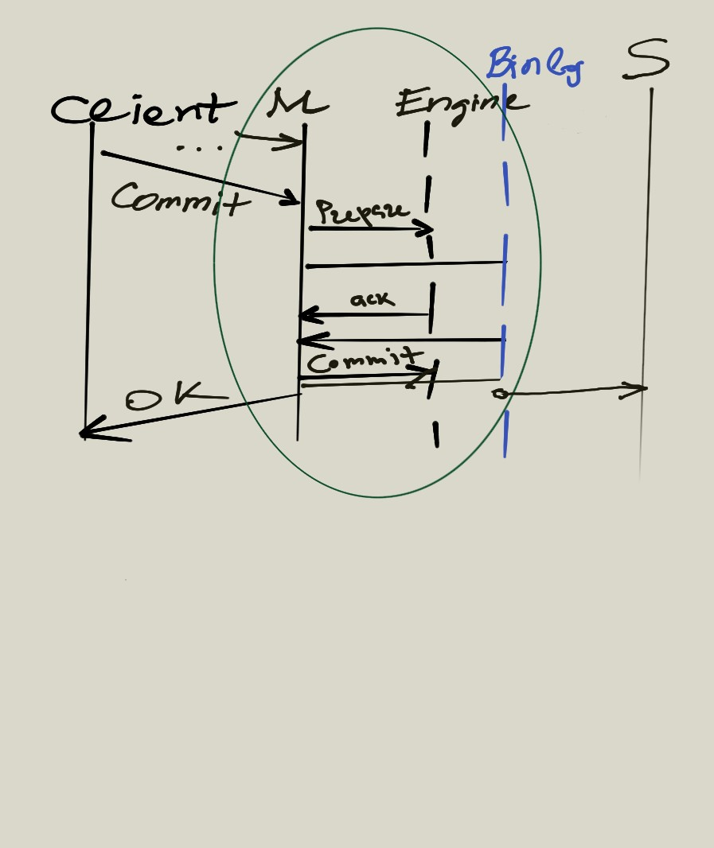
Replication conceptually is 2PC

Slide 4
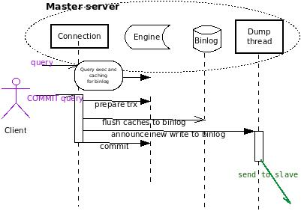
Binary logging and data shipping to slave

Slide 5
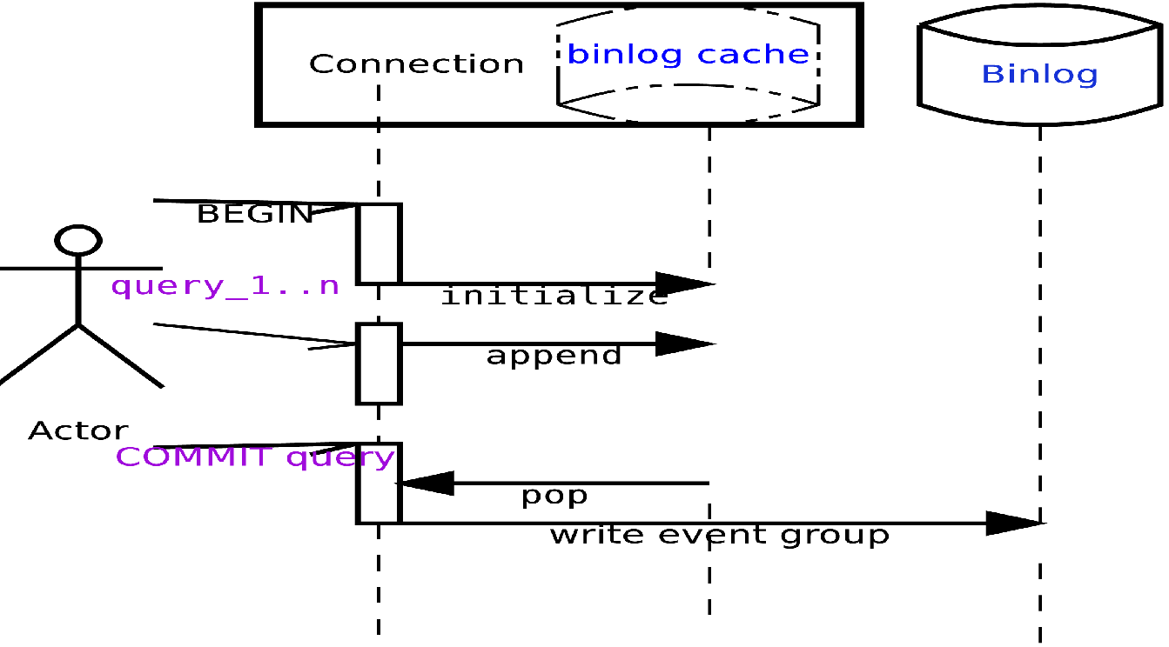
Connection’s private binlog cache

Slide 6
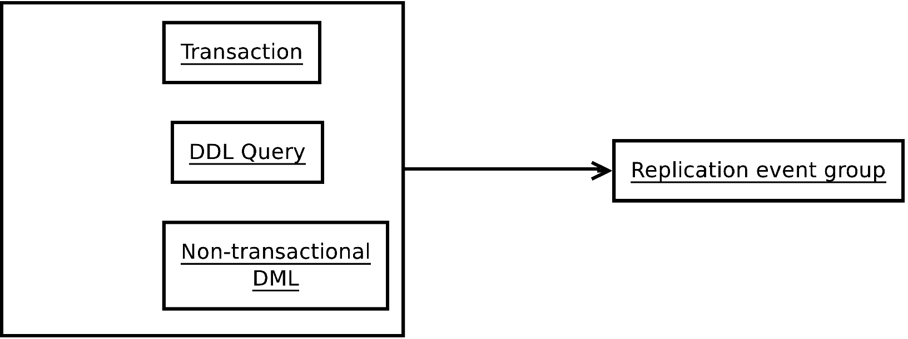
binary logging: event group

Slide 7
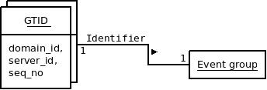
GTID

Slide 8
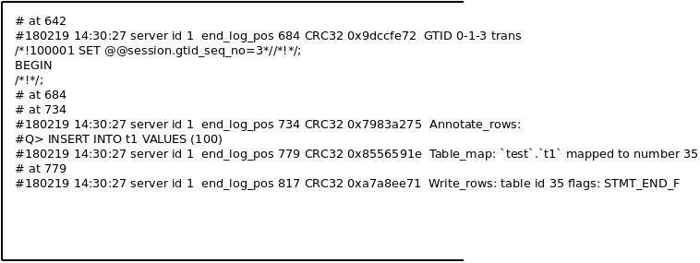
event group: example

Slide 9
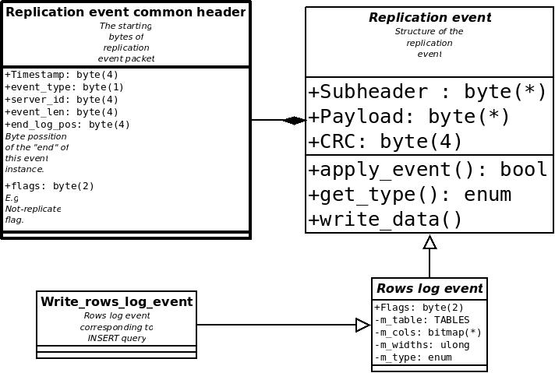
Events: byte format and hierarchy

Slide 10
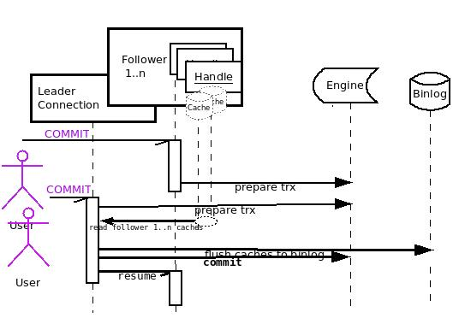
Binlog Group Commit

Slide 11
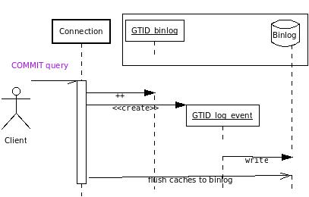
Binlogging: GTID

Slide 12
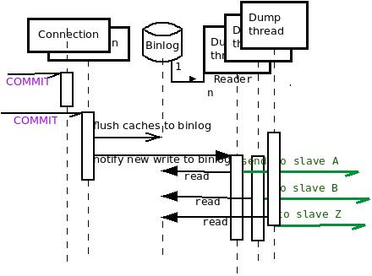
Events shipping: Dump thread

Slide 13
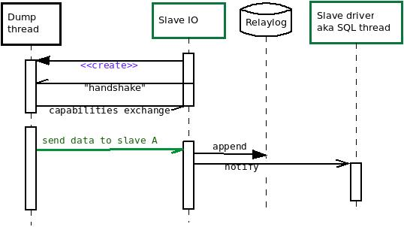
Events receiving: IO thread

Slide 14
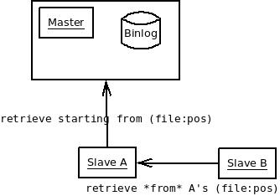
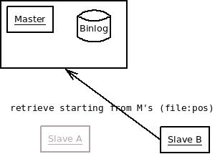
GTID: Limits of (file:pos)

Slide 15
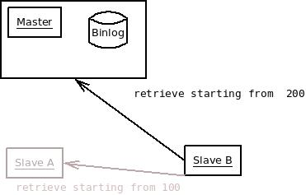
GTID idea

Slide 16
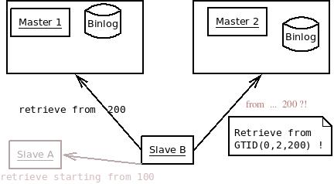
GTID: motivation by MSR

Slide 17
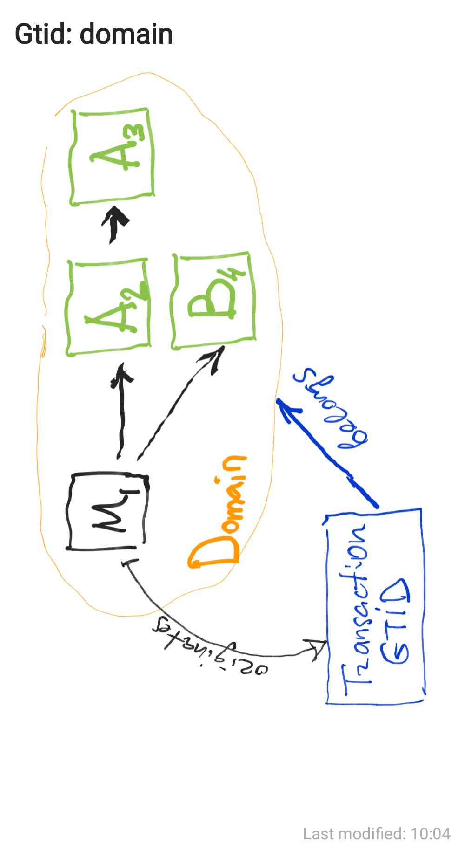
GTID: domain idea

Slide 18
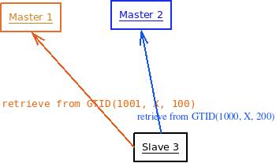
GTID and Multi-Sourced Replication
Transactions from different domains are executed independently

Slide 19
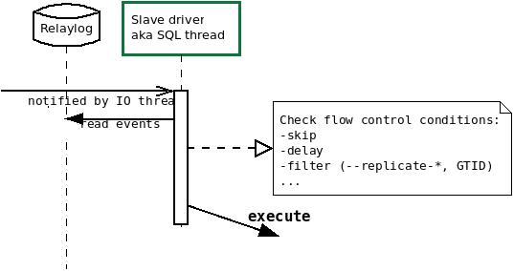
Events execution: single-threaded mode

Slide 20
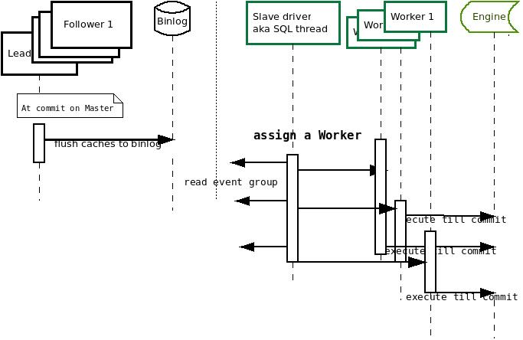
Events execution: parallel scheduling

Slide 21
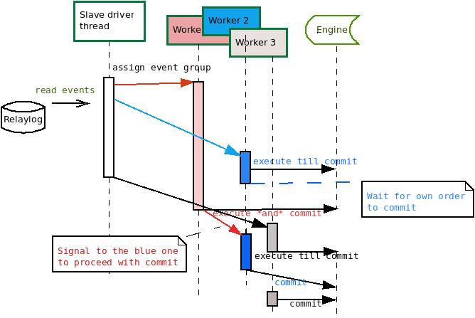
Events execution: ordered commit

Slide 22
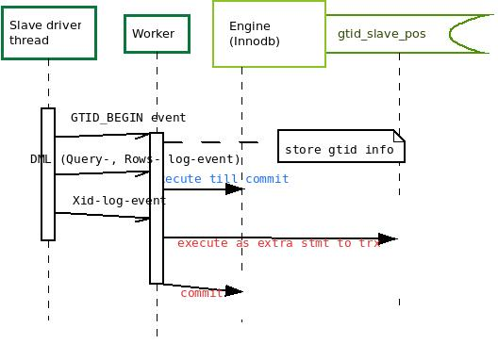
GTID execution: gtid_slave_pos table

Slide 23
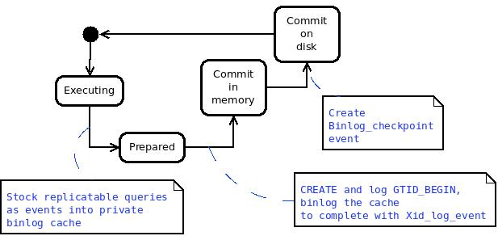
Recovery: committed data may be lost

Slide 24
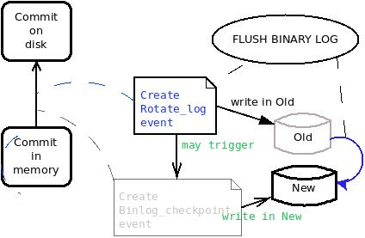
Recovery without Binlog_checkpoint

Slide 25
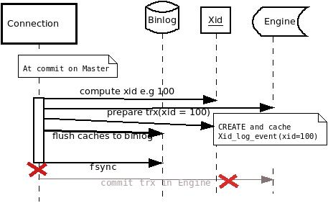
Recovery: server crash

Slide 26
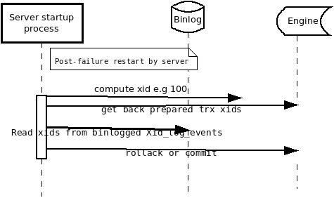
Recovery: post-restart decisions

Slide 27
Recovery on slave
TODO/Optional: Slave side (--relay-log-recovery, --gtid-*-recovery; reconnect)

Slide 28
Events flow control
Filters on master incl ‘no_replicated’, @@sql_log_bin, --binlog-{do,ignore...}
Filters on slave incl –replicate-{same-server-id,{do-,ignore-}db}
GTID constraints (strict vs non-strict mode, --gtid-ignore-duplicates)

Slide 29
Ongoing and promising projects
XA replication MDEV-7974
Towards eager replication (Online Alter replication in the style of MDEV-7974)
Balanced parallel applier
Relay-log-less applier
Committed GTID tracker by engine (engine trx_id to GTID mapping)
Binlog-less “relay” slave in chain replication
Paxos-like mode semi-sync

Slide 30
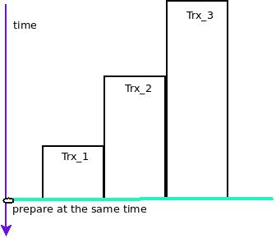
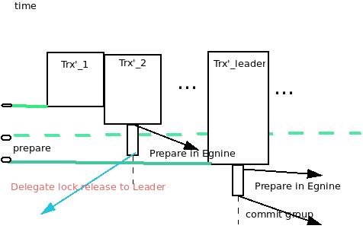
Parallel slave: group commit

Slide 31
References:
MDEV-XYZ
http://mariadb…
Blogs://...
White papers ...

Slide 32
Thanks:
Contributor list: {…} /* todo: in style of the end of movie roll*/

Slide 33
^D
Todo: last page. Thank you all!

