Slide 1


BreachDirectory.com
MariaDB Indexes Revisited
Beyond the Documentation
@lukasvileikis_
lukasvileikis.com/feedback.php

Slide 2



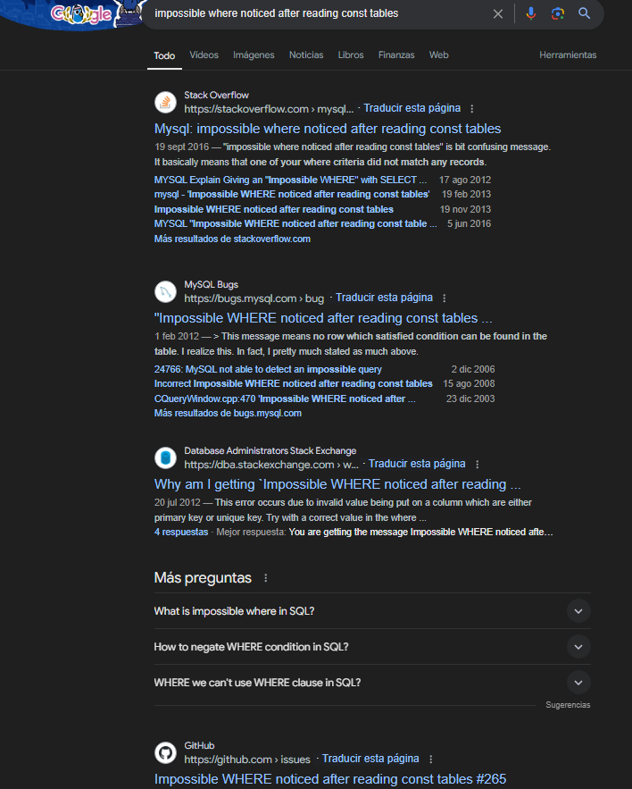



Slide 3

CONTENTS
01
02
03
04
Index Types
Documentation
Beyond the Documentation
???
& Summary

Slide 4
BreachDirectory.com
CONTENTS
01
02
03
04
Index Types
Documentation
Beyond the Documentation
???
& Summary
@lukasvileikis_
lukasvileikis.com/feedback.php

Slide 5


BreachDirectory.com
Overview
What is an Index?
An index is a data structure that helps your database quickly find rows.
Types of Indexes
B-Tree {Covering, Composite, Clustered, Descending, FULLTEXT, Unique, Hash, PRIMARY KEY}
R-Tree {Spatial}
@lukasvileikis_
lukasvileikis.com

Slide 6
BreachDirectory.com
@lukasvileikis_
lukasvileikis.com

Slide 7
BreachDirectory.com
Full-Text & Composite Indexes
Essentials
Surface
EXPLAIN
ANALYZE TABLE
Foreign Keys
Index Statistics
@lukasvileikis_
lukasvileikis.com

Slide 8
BreachDirectory.com
Key columns
EXPLAIN|DESCRIBE
Documentation
Covering Index
...
Ignored Indexes*
Primary Keys
*Added in MariaDB 10.6.
@lukasvileikis_
lukasvileikis.com

Slide 9
BreachDirectory.com
Using index condition
Using where
Internals
Impossible where noticed after reading const tables
Using filesort
@lukasvileikis_
lukasvileikis.com
Notes:
What’s shown is an Extra column information for the EXPLAIN query
Using the index condition means that MySQL filters rows by using the index and then uses the table to retrieve the matched rows.
Using a WHERE clause can have different meanings. Some argue that this piece of information is frequently inconsistent at best, but in this specific case, it most likely means that the expression within a WHERE clause performed an index seek operation.
Using a filesort operation means that rows in the table were read and sorted during an extra sorting phase during query execution.

Slide 10

BreachDirectory.com
Meaning
01
03
04
02
Using filesort
Using the index condition
Rows were read and sorted during an extra sorting phase during query execution
Database filters rows using the index and uses the table to retrieve matched rows
Using a WHERE clause
Impossible WHERE
The expression within a WHERE clause performed an index seek operation
Query doesn’t make any sense
@lukasvileikis_
lukasvileikis.com

Slide 11





BreachDirectory.com
Action Plan
Use Case
Choose an Index Type
Apply the Index Type
Test & Deploy
Evaluate your use case
Based on your use case, choose an index type
Adding a B-Tree index for most use cases
Run queries with the EXPLAIN clause
@lukasvileikis_
lukasvileikis.com

Slide 12
BreachDirectory.com
Takeaways
Covering indexes mean speed
Storage engines and my.cnf
Use indexes and partitions
Use the proper type of index
Data types and character sets
Index the column after WHERE clause
What columns are indexed?
Select only the necessary rows
Does indexing make sense?
@lukasvileikis_
lukasvileikis.com
Notes:
No UNIQUE INDEX on a TEXT column
Index key prefix length limit depends on the row format (DYNAMIC|COMPRESSED – 3072 bytes, REDUNDANT|COMPACT – 767 bytes)

Slide 13



BreachDirectory.com
01
Not all indexes are used
Indexing all columns is not necessarily bad
02
03
Modifying indexes makes a copy of the table on the disk
Index cardinality:
uniqueness of values
04
@lukasvileikis_
lukasvileikis.com
Notes:
If approximately 30% of the values in the field are of one value, index isn't used
Modifying indexes with ALTER TABLE makes a copy of the table on the disk – DEFAULT clause can help with this

Slide 14

BreachDirectory.com
Test & Deploy
1. Ensure Necessity (Locally)
01
02
2. Deploy (Locally)
Deploy (add) indexes on a replica server
Ensure that the indexes you add are the indexes that are necessary for you to use
3. Replicate on a Live Server
4. Test & Run!
03
04
Test your query performance once again.
Most likely you’re good to go!
Ensure your database load is low before adding indexes
@lukasvileikis_
lukasvileikis.com

Slide 15
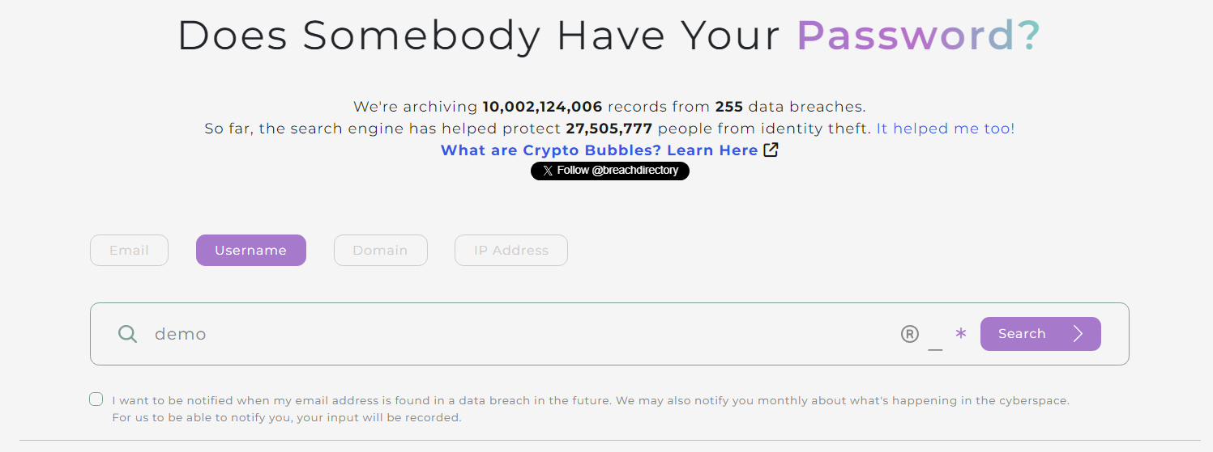
BreachDirectory.com
@lukasvileikis_
lukasvileikis.com

Slide 16


BreachDirectory.com
Additional Resources
Useful Websites
Books
MariaDB Documentation
DBA StackExchange
YouTube & Beyond @DatabaseDive
Hacking MySQL: Breaking, Optimizing, and Securing MySQL for Your Use Case by Lukas Vileikis
Relational Database Index Design and the Optimizers by Tapio Lahdenmäki, Mike Leach
@lukasvileikis_
lukasvileikis.com

Slide 17
BreachDirectory.com
Thank You!
  Hope you’ve learned something new. ☺
  Blog – lukasvileikis.com
  DBSE – BreachDirectory.com
  Book – HackingMySQL.com
  YouTube – @DatabaseDive
  https://lukasvileikis.com/feedback.php
@lukasvileikis_
lukasvileikis.com

