Slide 1
Upstream Pilot AI Tool
Bardia Hassanzadeh, PhD

Slide 2
Overview
Background
Development Phase 1: Single-agent Workflow
Development Phase 2: Assisted Multi-Agent Workflow
Development Phase 3: Autonomous Multi-Agent Workflow
Showcase: Current Progress
Showcase: RDS Hackathon Day Results
1

Slide 3
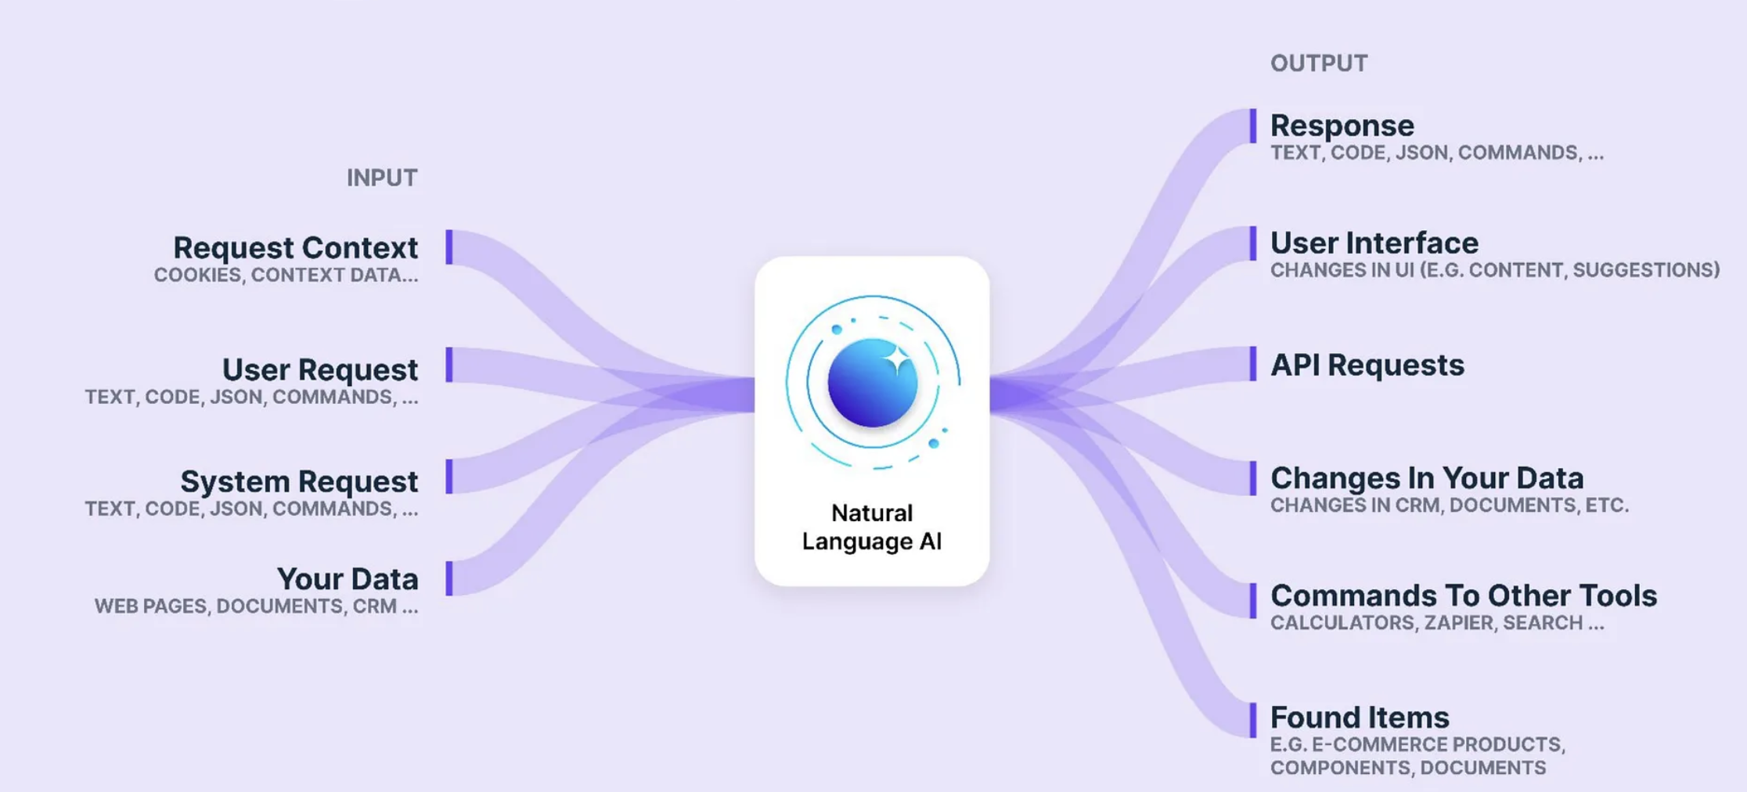
Background - Large Language Models (LLMs)
Definition: Large Language Models (LLMs) are powerful machine learning models capable of understanding, generating, and manipulating human-like text based on extensive training data.
Examples: GPT from OpenAI, Claude from Amazon Bedrock
Working Principles: Transformer architecture, Attention mechanisms, Training on vast text datasets
Applications in Software Development: Code generation, debugging support, documentation automation, natural language processing for issue analysis
Limitations: Hallucinations, context limitations, reliance on large computational resources
2

Slide 4
Background - Retrieval-Augmented Generation (RAG)
Definition: RAG combines retrieval mechanisms with LLMs to enhance generation accuracy by providing relevant contextual information.
Importance: Helps LLMs generate contextually accurate and up-to-date responses, critical for precise code generation and problem-solving.
Components: Retrieval module (searches for relevant content), Generation module (uses retrieved content to inform responses)
Example Use-cases: Documentation retrieval, historical issue resolution lookup, contextual enhancement in coding tasks
Benefits: Reduces inaccuracies, improves reliability of LLM-generated outputs, enhances user trust
3

Slide 5
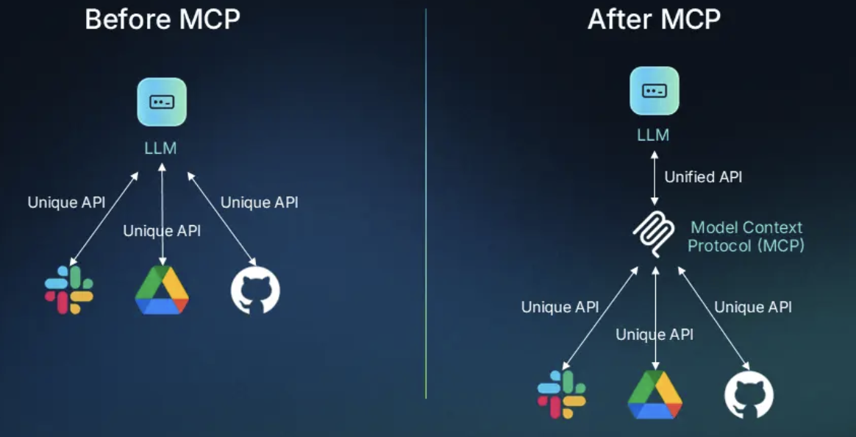
Background - Model Context Protocol (MCP)
Definition: MCP is a protocol designed to enhance transparency, reproducibility, and traceability of AI-generated outputs by bundling all contextual data used during generation.
Purpose: Ensures outputs can be audited, reproduced, and understood by human reviewers or downstream applications.
Example Use-cases: Integration into IDE plugins, CI/CD pipelines, and review processes for complete traceability
Benefits: Increased transparency, enhanced reproducibility, improved reliability and trust in automated solutions
4

Slide 6
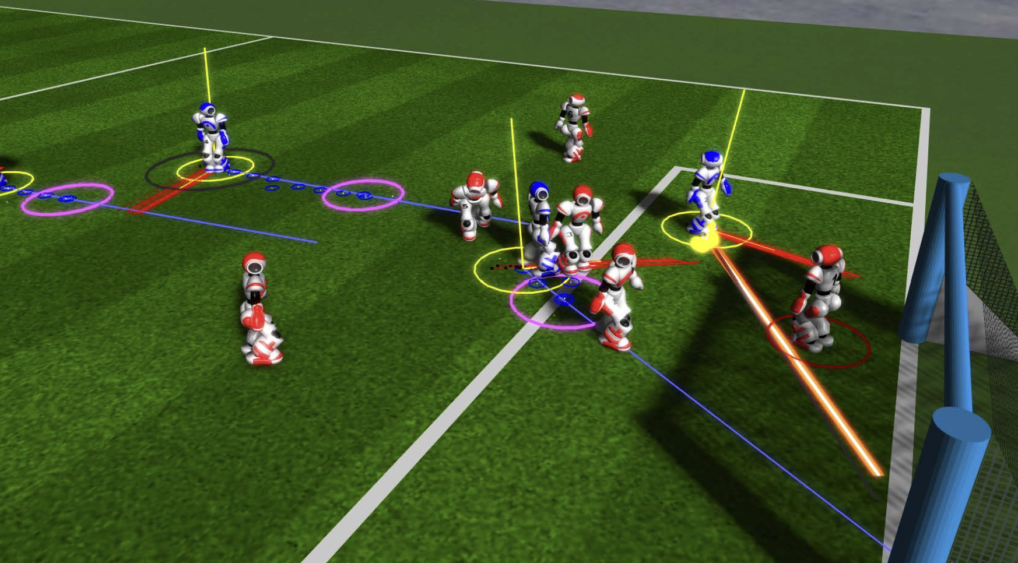
Background - Multi-Agent Systems
Definition: Multi-agent systems consist of multiple intelligent agents working collaboratively to solve complex problems by dividing tasks into specialized roles.
Core Concepts: Agents, environments, interactions, collaboration mechanisms, task specialization
Agent Roles in Software Development: Retrieval (gather context), Planning (outline steps), Coding (code implementation), Debugging (error correction), Review (quality assurance)
Advantages: Task specialization leading to higher efficiency, collaborative problem-solving, increased scalability
Practical Examples: Automated ticket handling, issue resolution, collaborative coding, distributed debugging
5

Slide 7
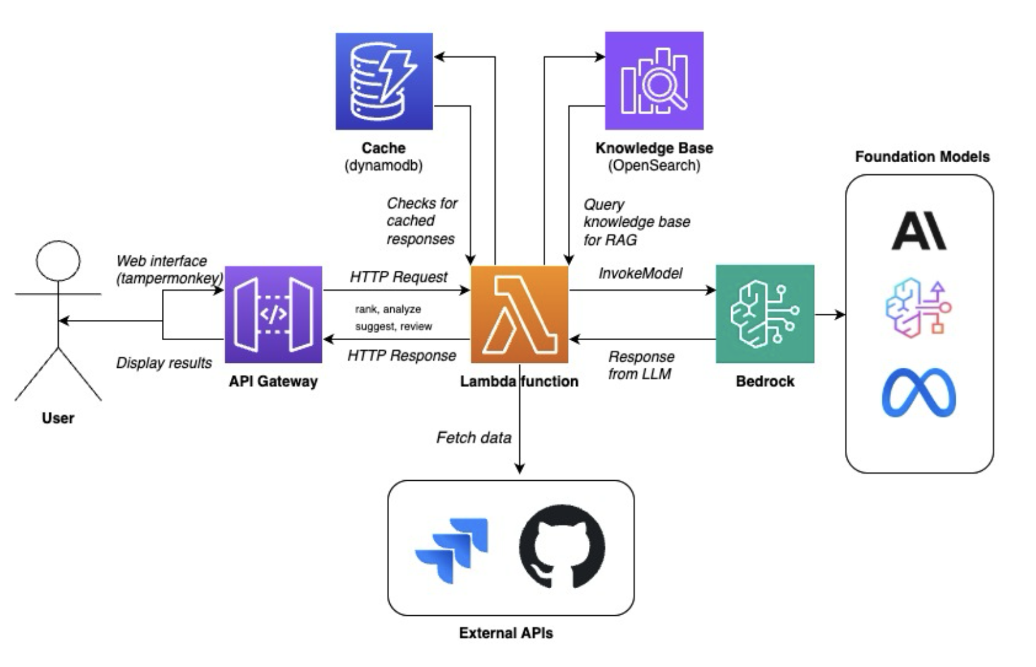
Phase 1 - Single-Agent Workflow
Core Components​
​
Serverless Architecture: Utilizes AWS Lambda for orchestration.​
API Interaction:​
Requests enter through an API Gateway.​
Forwarded to a central Lambda function for routing.
6

Slide 8
Phase 1 - Single-Agent Workflow
Functionality & Workflow
1. Request Handling:
Central Lambda router directs requests based on the API call type (e.g., ranking Jiras, analyzing).
2. Data Storage and Retrieval:
DynamoDB cache used for quick access to frequent queries.
OpenSearch knowledge base employed for intelligent, context-aware responses.
3. AI Integration:
AWS Bedrock enhances core processing with AI capabilities.
Connects to foundation models for advanced analysis and suggestions.
4. External Integrations:
Interfaces with Jira and GitHub APIs for task discovery and codebase access.
7

Slide 9
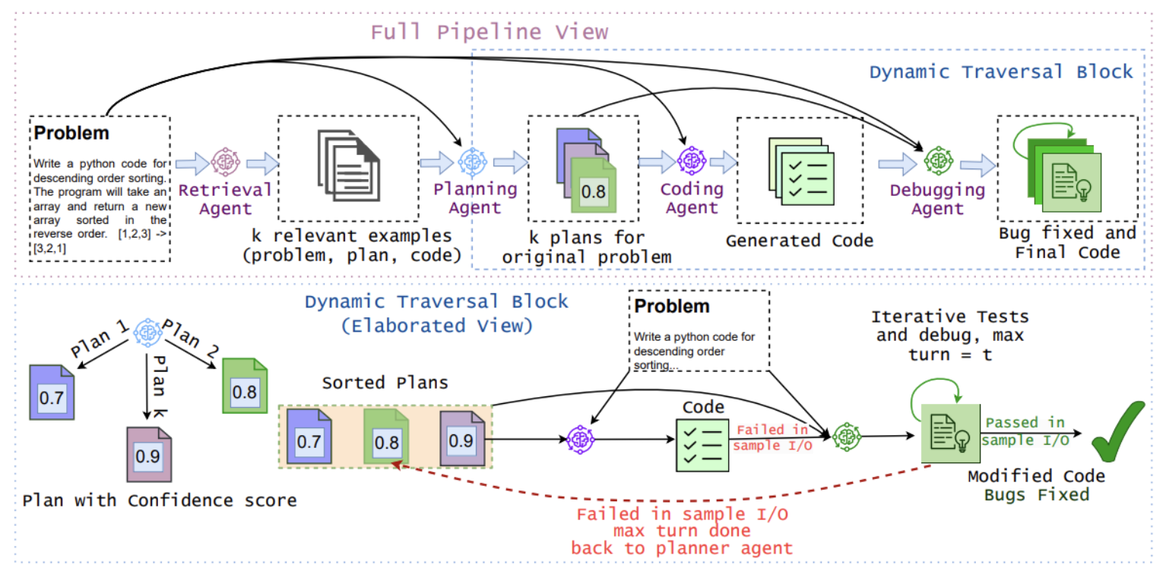
Phase 2 - Assisted Multi-Agent
Initial phase supports human developers by automating routine tasks and providing
comprehensive contextual insights for better decision-making.
8

Slide 10
Phase 2 - Assisted Multi-Agent Workflow
Agent Functions:
• Retrieval Agent: Contextual analysis of Jira tickets using embeddings from Amazon Bedrock.
• Planning Agent: Generation of multiple confidence-ranked action plans.
• Coding Agent: Transformation of plans into executable code snippets, leveraging diverse approaches through adaptive temperature settings.
9

Slide 11
Phase 2 - Assisted Multi-Agent Workflow [continued]
Agent Functions [Continued]:
• Debugging Agent: Advanced state-checkpoint debugging inspired by MAGE, allowing pinpoint accuracy in diagnosis and quick fixes.
• Review Agent: Automated code review including compliance checks, licensing, and security standards.
• MCP Export Agent: Packaging and traceability of contributions for developer review.
• Integration: AWS Lambda, Bedrock, OpenSearch, Step Functions
10

Slide 12
Phase 2 - Benefits
• Efficiency Gains: Significant reduction in manual repetitive tasks, allowing developers to concentrate on complex aspects of coding and debugging.
• Consistency and Quality: Automated standardization of coding and debugging practices, reducing variability and ensuring high-quality contributions.
• Reduced Cycle Time: Faster resolution of Jira tickets through streamlined workflows and rapid automated code generation and debugging.
• Improved Review Processes: Automated checks for policy compliance, code quality, and security standards, reducing manual review overhead.
• Enhanced Developer Experience: Lower cognitive load, improved satisfaction and productivity for developers.
Key Benefits: Increased productivity, reduced errors, quicker contribution cycles, higher quality outputs
11

Slide 13
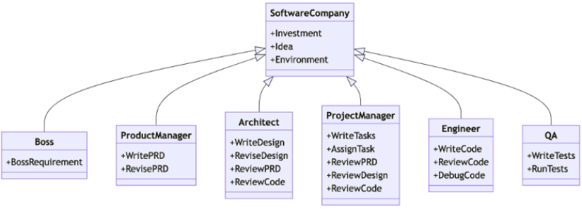
Phase 3 - Autonomous Multi-Agent
Autonomous operation with minimal human intervention, leveraging advanced machine learning methods for continuous performance improvement.
12

Slide 14
Phase 3 - Autonomous Multi-Agent Workflow
Advanced AI Methods:
• Reinforcement Learning: Agents improve decision-making strategies based on feedback loops from outcomes and performance metrics.
• Meta-Learning: Rapid adaptation of agent behaviors to handle evolving and diverse MariaDB development tasks effectively.
• Human-in-the-loop Fine-tuning: Structured feedback mechanisms for continuous refinement of agent models.
• Adaptive Operations: Continuous updating of implementation plans and debugging strategies based on real-time data and outcomes.
11

Slide 15
Phase 3 – Benefits and Long-Term Plan
Benefits:
• Significant reduction in developer intervention, further freeing up developer time. • Continuous adaptation and improvement through reinforcement learning and feedback integration. • Higher accuracy and reliability in generated solutions, reducing maintenance and operational overhead.
Strategic Impact: • Enhanced contribution capabilities to MariaDB, significantly increasing Amazon’s open-source influence and leadership. • Foster more collaborative and efficient open-source development practices, promoting innovation and quality within the MariaDB community.
Long-term Objective:
Transition to a fully autonomous system capable of independently handling and resolving a majority of Jira tickets from MariaDB Foundation.
13

Slide 16
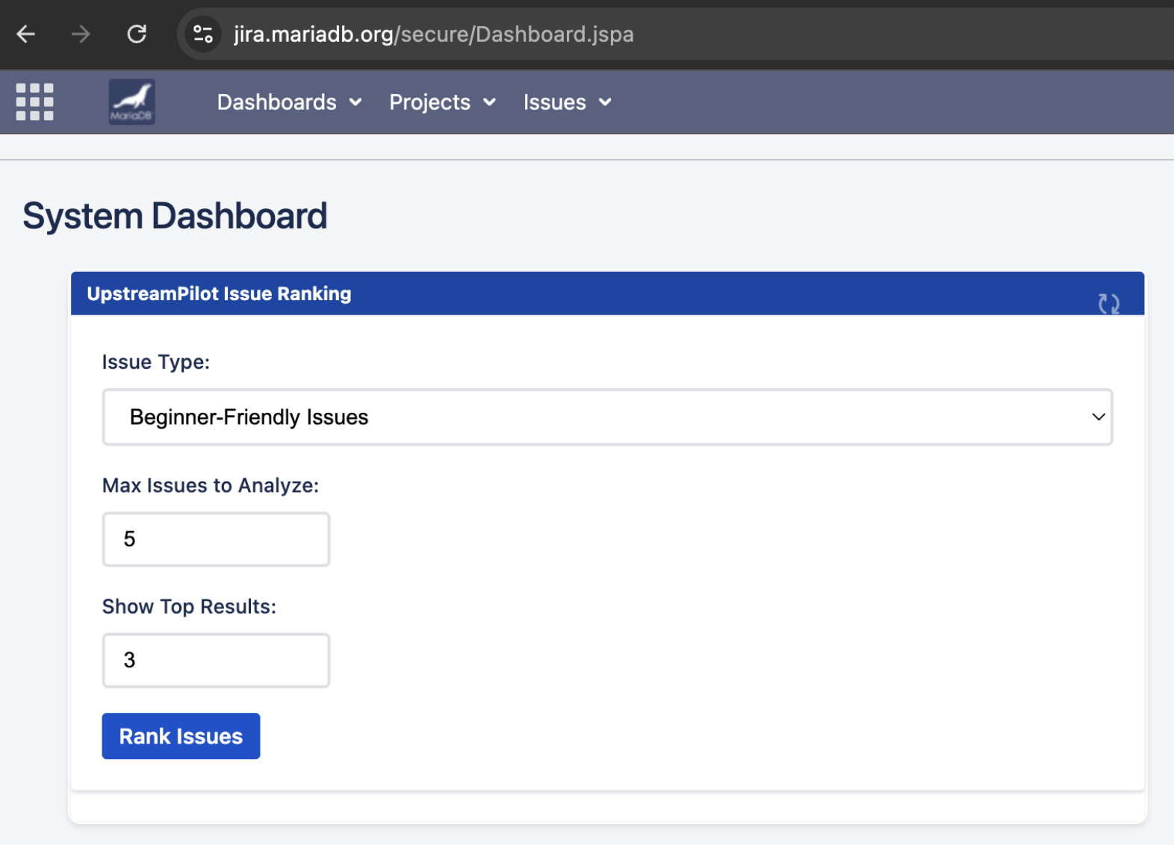
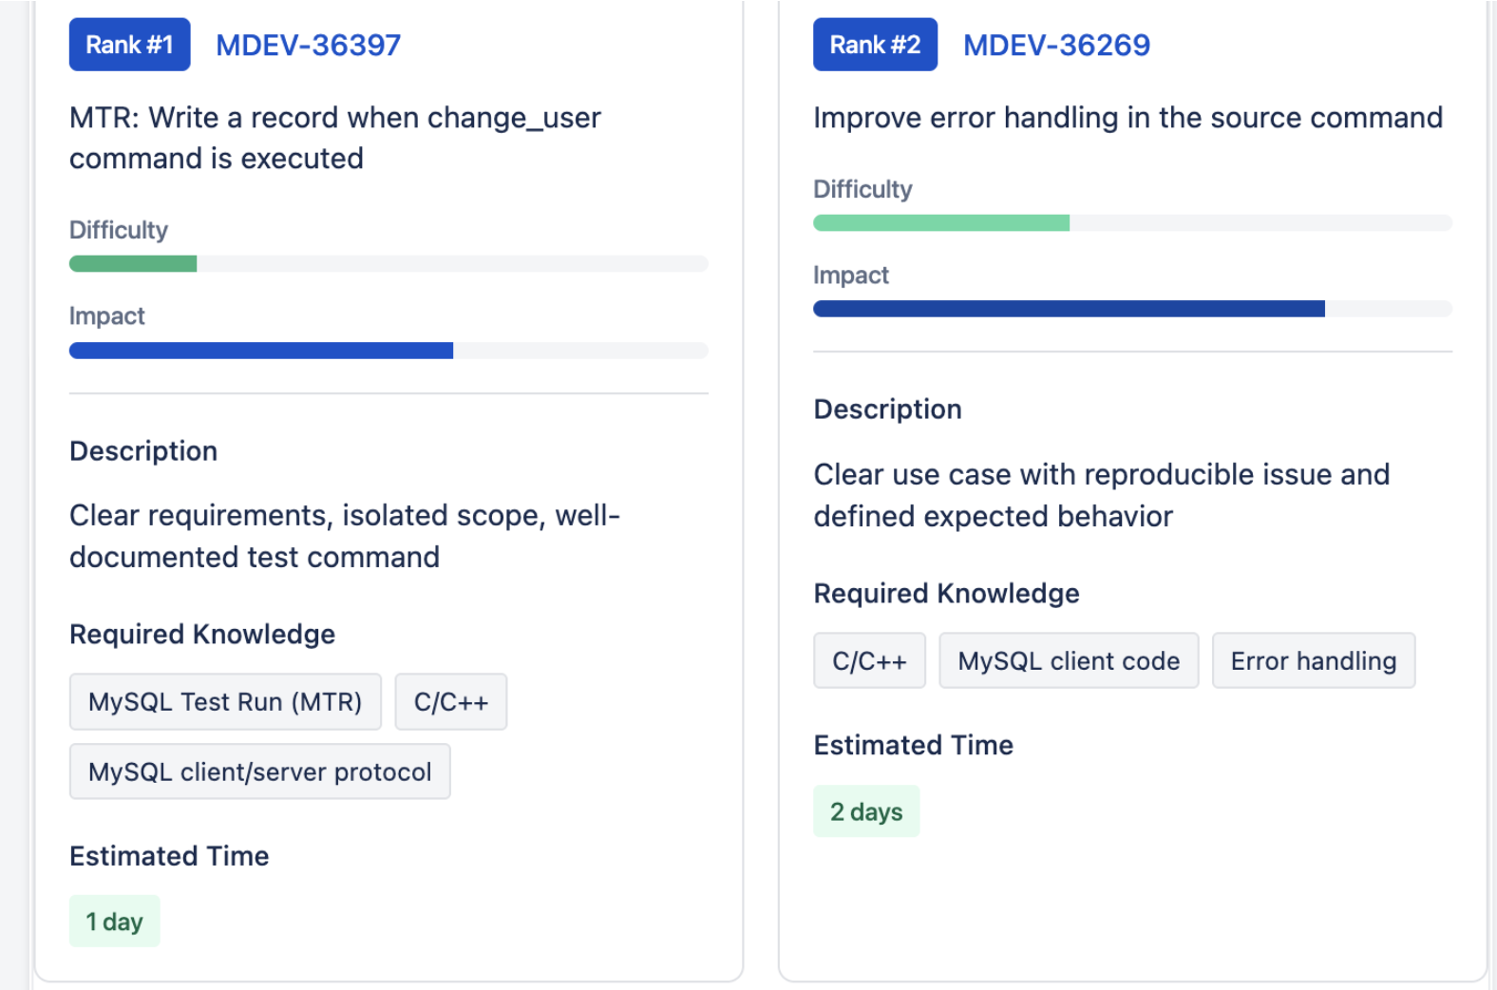
Showcase: Current Progress
14

Slide 17
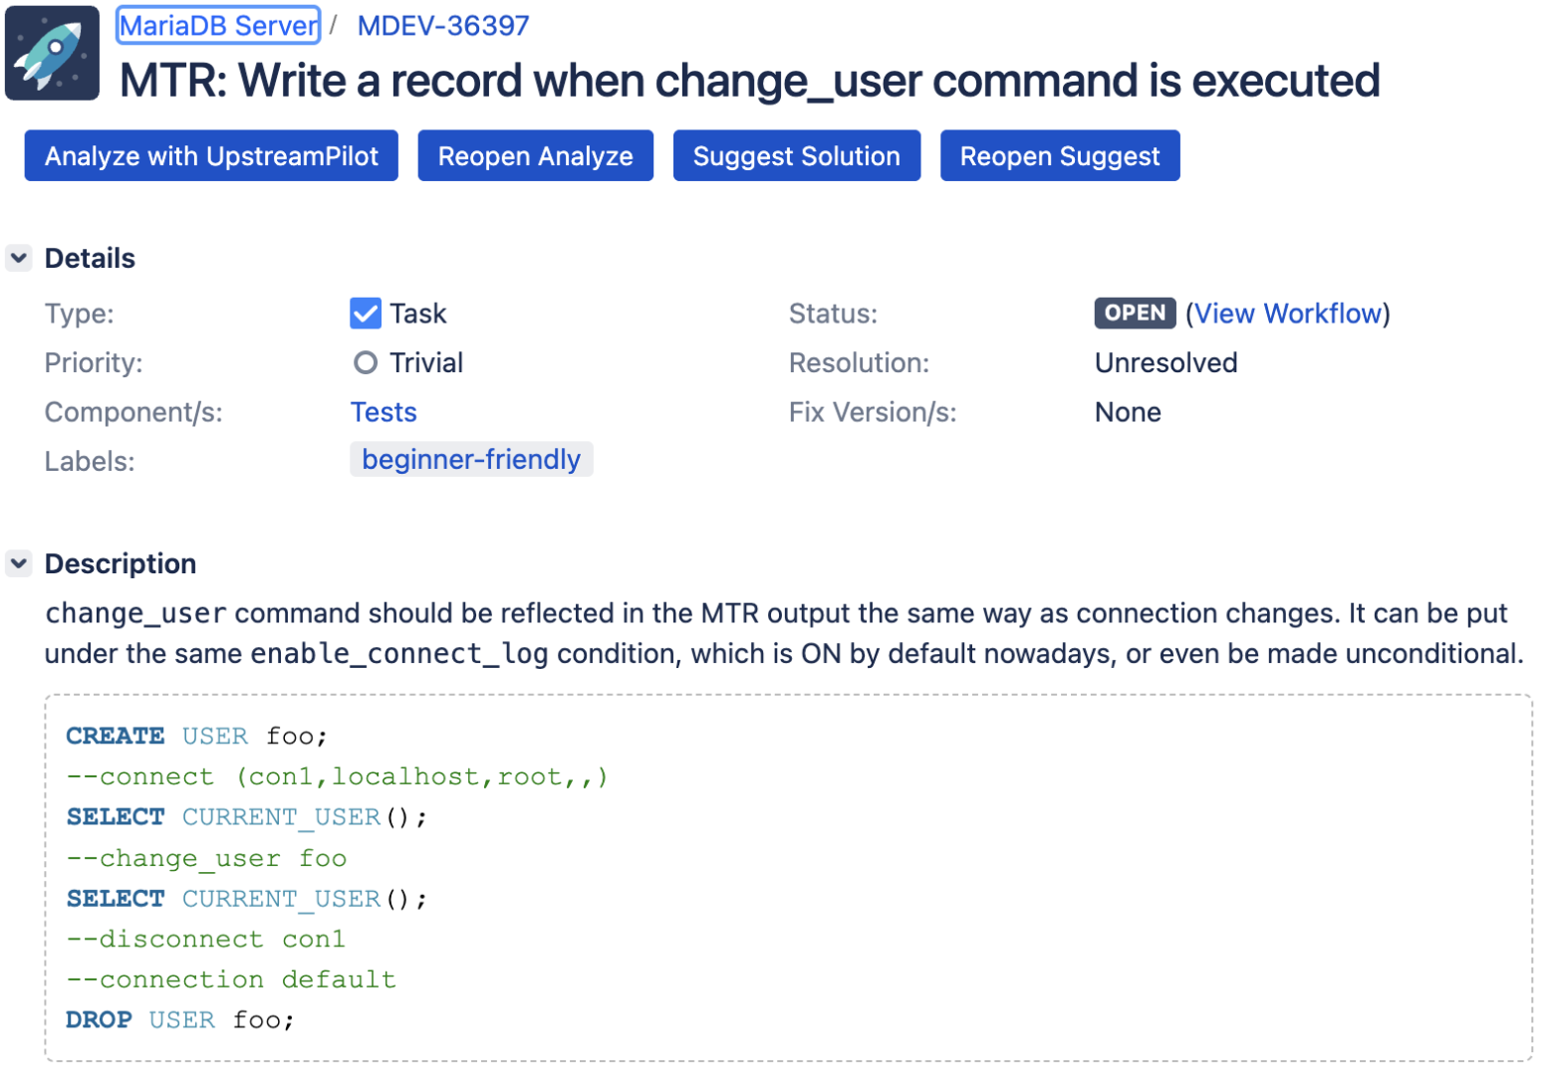
Showcase: Current Progress [Continued]
15

Slide 18
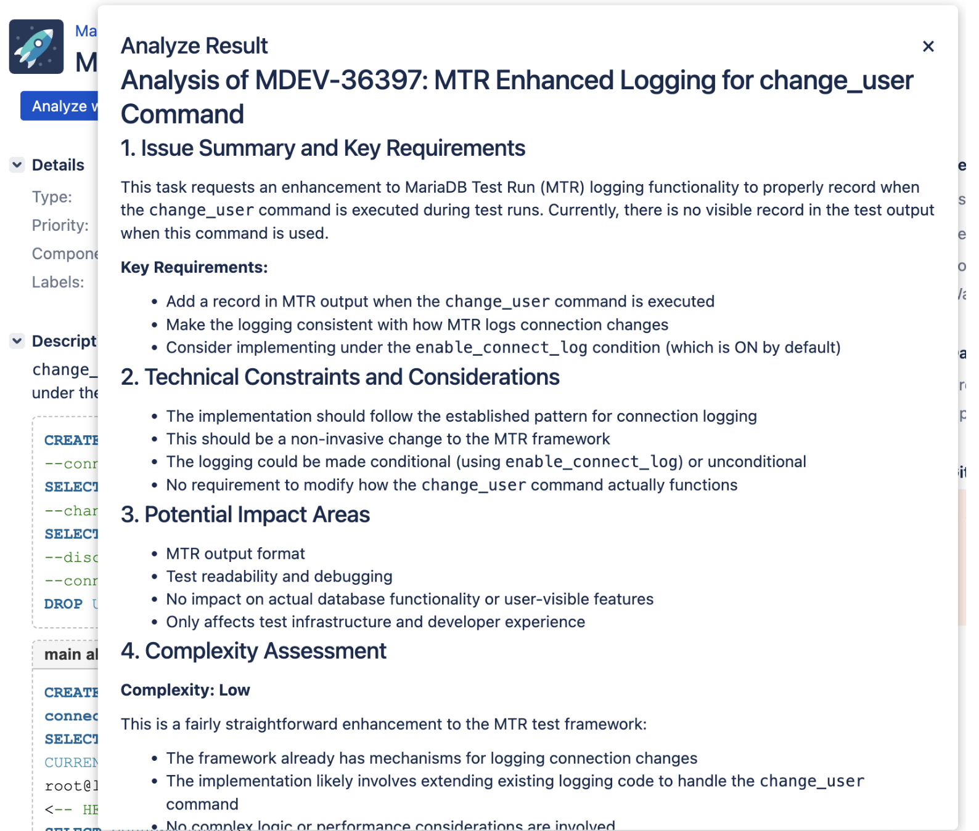
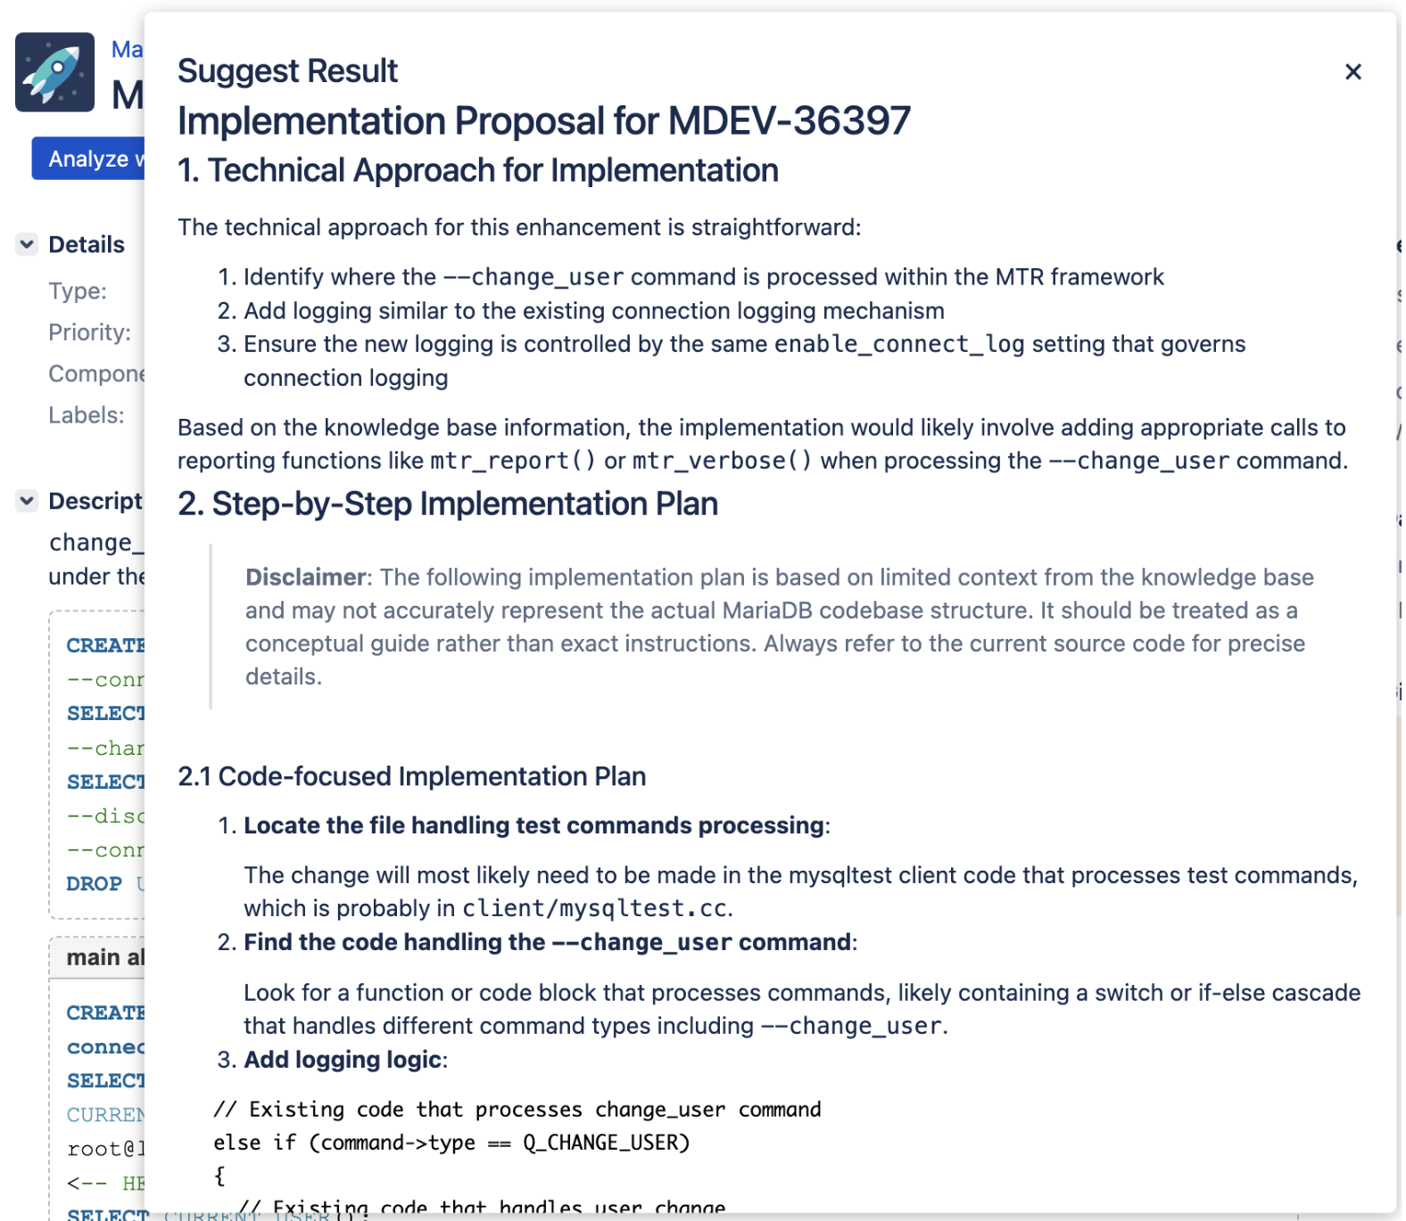
Showcase: Current Progress [Continued]
17

Slide 19
Showcase: Amazon RDS Hackathon Day Results
Event Overview
Date: April 2025 Hackathon
Team: RDS Core Engine
Participants: 6 Developers
Duration: 9 am - 5 pm (Isolated Environment)
Process Workflow
1. Ticket Selection:
Utilized Upstream Pilot's bulk-ranking feature to choose Jira tickets.
2. Analysis and Understanding:
Employed Upstream Pilot’s analysis tool for deeper insight into ticket requirements.
3. Implementation and Testing:
Followed suggestions from Upstream Pilot for implementation.
Designed tests based on guidance.
17

Slide 20
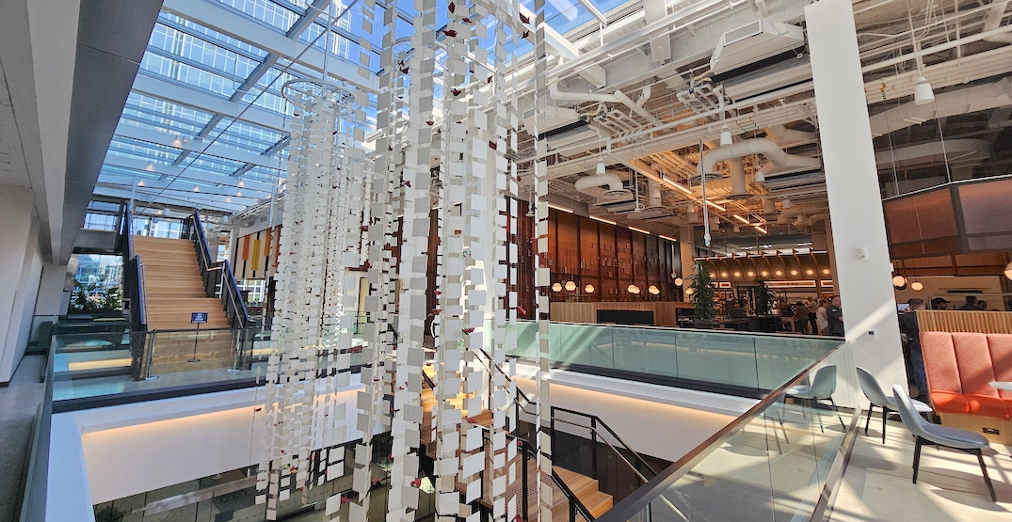
Showcase: Amazon RDS Hackathon Day Results [Continued]
Results Summary
Submission Completion:
4 Developers submitted contributions by end of session.
Remaining 2 continued in subsequent days.
Time Efficiency Improvements:
Ticket Selection:
Average Time with Upstream Pilot: ~20 minutes
Previous Average Time: ~72 minutes
Improvement: ~70%
Analysis and Suggestion Usage:
Average Time: ~3 hours
Test Design Implementation:
Average Time: ~1-2 hours
19

Slide 21
Showcase: RDS Hackathon Day Results [Continued]
Upstream Contributions:
MDEV-35461: Remove redundant checks for standard library functions
MDEV-28823: Secure mariadb-secure-installation output file with chmod
MDEV-36397: Record change_user command in MTR output
MDEV-36641: Implement Oracle Compatibility - INITCAP function
MDEV-35599: Which llstr(value, buff) can we replace with "%lld" ?
20

Slide 22
THANK YOU!

